Slide 1
Arrays, Addressing Modes, and String Instructions
CSE 315
Microprocessors, Microcontrollers, and Embedded Systems

Slide 2
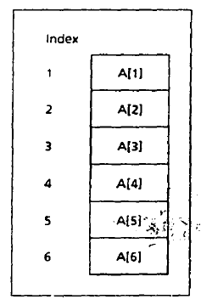
One Dimensional Array
A one dimensional array is an ordered list of elements
A 5 character string named MSG
MSG DB ‘abcde’
A word array W of 6 integers
W DW 10, 20, 30, 40, 50, 60

Slide 3
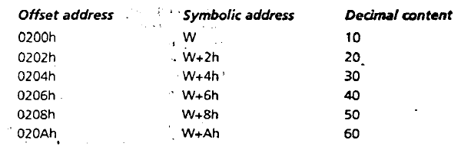
One Dimensional Array
The address of the array variable is called the base address of the array
The array W is like this

Slide 4
DUP operator
repeat_count DUP (value)
An array of 100 words, each initialized to 0
GAMMA DW 100 DUP (0)
An array of 212 uninitialized bytes.
DELTA DB 212 DUP (?)
Nested DUP operator
LINE DB 5, 4, 3 DUP (2, 3 DUP (0), 1)
is equivalent to
LINE DB 5, 4, 2, 0, 0, 0, 1, 2, 0, 0, 0, 1, 2, 0, 0, 0, 1

Slide 5
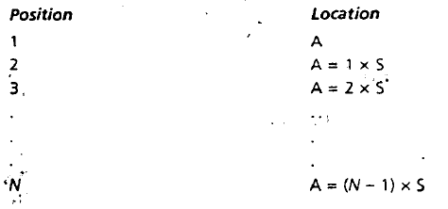
Location of Array Elements
A is an array of N elements
S is the number of bytes in an element of the array
S = 1 (for byte array)
= 2 (for word array)
So, the location of the elements of A can be determined as

Slide 6
Addressing Modes
So far we have used
Register mode operand is a register
Immediate mode operand is constant
Direct mode operand is a variable
MOV AX, 0 ; Destination AX is register mode, source 0 is immediate mode
ADD X, AX ; Destination X is direct mode, source AX is register mode
There are four additional addressing modes
Register indirect mode
Based mode
Indexed mode
Based indexed mode

Slide 7
Register Indirect Mode
The offset address of the operand is contained in a register.
Operand format [register]
Register can be BX, SI, DI, or BP.
If BX, SI, or DI contains the offset of the operand, DS contains the segment number
If BP contains the offset of the operand, SS contains the segment number

Slide 8
Register Indirect Mode
Write a code to sum in AX the elements of the 10-element array W defined by
W DW 10, 20, 30, 40, 50, 60, 70, 80, 90, 100
XOR AX, AX ; AX holds sum
LEA SI, W ; SI points to array W
MOV CX, 10 ; CX has number of elements
ADDNOS:
ADD AX, [SI] ; sum=sum+element
ADD SI, 2 ; move pointer to the next element
LOOP ADDNOS ; loop until done

Slide 9
Based Mode
Operand format [register + displacement]
[displacement + register]
[register] + displacement
displacement + [register]
displacement [register]
Register can be BX (base register), or BP (base pointer)
Displacement can be
the offset address of a variable (e.g., A)
a constant (positive or negative) (e.g., -2)
the offset address of a variable plus or minus a constant (A + 2)
If BX is used as register, DS contains the segment number
If BP is used as register, SS contains the segment number

Slide 10
Based Mode
Suppose W is a word array and BX contains 4
Displacement is the offset address of variable W.
So, to move the 3rd element of the array to AX, we can write
MOV AX, [BX + W] ;[register + displacement]
MOV AX, [W + BX] ;[displacement + register]
MOV AX, [BX] + W ;[register] + displacement
MOV AX, W + [BX] ;displacement + [register]
MOV AX, W [BX] ;displacement [register]

Slide 11
Indexed Mode
Operand format [register + displacement]
[displacement + register]
[register] + displacement
displacement + [register]
displacement [register]
Register can be SI (source index), or DI (destination index)
Displacement can be
the offset address of a variable (e.g., A)
a constant (positive or negative) (e.g., -2)
the offset address of a variable plus or minus a constant (A + 2)
If SI, or DI is used as register, DS contains the segment number

Slide 12
PTR operator
Instructions such as
MOV [BX], 1
is not allowed since whether the destination is byte or word is unknown
The PTR operator can be used for type casting
MOV BYTE PTR [BX], 1
MOV WORD PTR [BX], 1

Slide 13
LABEL pseudo-op
MONEY LABEL WORD
DOLLARS DB 1Ah
CENTS DB 52h
The declaration types MONEY as a word variable with components DOLLARS AND CENTS as byte variables

Slide 14
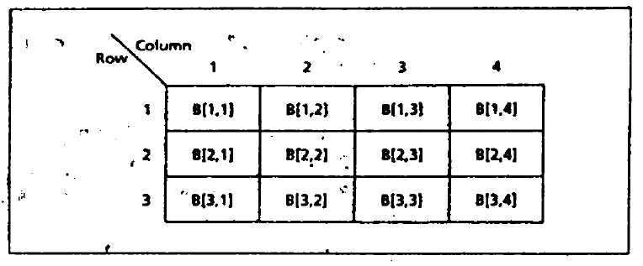
Two Dimensional Arrays
Two dimensional arrays are arrays of arrays

Slide 15
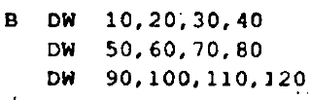
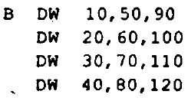
Two Dimensional Arrays
In assembly we can store them in row major order
Or in column major order
Most high level languages store them in row major order

Slide 16
Locating an element in a 2d array
Suppose an M by N array A is stored in a row major order
Size of the elements is S (S=1 for byte array and 2 for word array)
To find the location of j-th element in the i-th row
Find where row i begins
Find the location of the j-th element in that row
A[i,j] has address
A + ((i-1) × N + (j-1)) × S

Slide 17
Based Indexed Addressing Mode
The offset address of the operand is the sum of
The contents of a base register (BX or BP)
The contents of an index register (SI or DI)
Optionally, a variable’s offset address
Optionally, a constant
Operand format
variable [base register] [index register]
[base register + index register + variable + constant]
variable[base register + index register + constant]
constant[base register + index register + variable]

Slide 18
Based Indexed Addressing Mode
Suppose A is 5 by 7 word array stored in row major order. Write a code to
clear the 3rd row using based indexed mode
MOV BX, 28 ; BX indexes row 3
XOR SI, SI ; SI will index columns
MOV CX, 7 ; number of elements in row
CLEAR:
MOV A[BX] [SI], 0 ; clear third row, element j
ADD SI, 2 ; go to next column
LOOP CLEAR ; loop until done

Slide 19
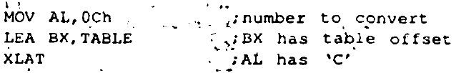
XLAT instruction
XLAT can be used to convert a byte value into another value that comes from a table
The byte to be converted must be in AL
BX must have the offset address of the conversion table

Slide 20
String instructions
Strings are byte or word arrays
String instructions
Copy a string
Search a string
Store characters
Compare strings

Slide 21
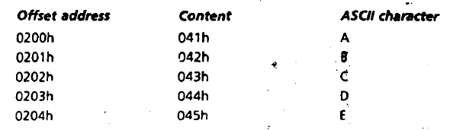
Strings and the Direction Flag (DF)
String operations are implemented by index registers SI and DI
STRING1 DB ‘ABCDE’
Suppose this string is stored in memory starting at offset 0200h
If DF = 0, SI and DI proceeds from left to right towards increasing address.
If DF = 1, SI and DI proceeds from right to left towards decreasing address.

Slide 22
CLD and STD
CLD ; clear DF (DF = 0)
STD ; set DF ( DF = 1)
CLD and STD have no effect on Flags register.

Slide 23
MOVSB and MOVSW
MOVSB ; move string byte
MOVSW ; move string word
Copies contents of address DS:SI (source) to the address ES:DI (destination).
Involves both ES and DS register, so we have to initialize both.
MOV AX,@DATA
MOV DS, AX
MOV ES, AX
Does a memory-memory operation.
Source byte/word is unchanged after move.
After move, both SI and DI are automatically increased (by 1/2) if DF = 0
After move, both SI and DI are automatically decreased (by 1/2) if DF = 1
Has no effect on the Flags

Slide 24
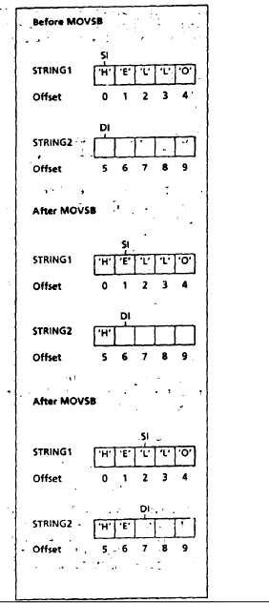
MOVSB
LEA SI, STRING1
;SI POINTS TO SOURCE STRING
LEA DI, STRING2
;DI POINTS TO DESTINATION STRING
CLD ;CLEAR DF
MOVSB
MOVSB

Slide 25
REP prefix
N = number of bytes in the source string
CX = N
The REP prefix causes MOVSB to be executed N times.
After each move CX is decremented until CX = 0.
CLD
LEA SI, STRING1
LEA DI,STRING2
MOV CX,5 ;no. of chars in STRING!
REP MOVSB

Slide 26
STOSB and STOSW
STOSB ; store string byte
STOSB moves the contents of AL register to the byte address ES:DI (destination).
DI is incremented if DF = 0 and decremented if DF = 1
STOSW ; store string word
STOSW moves the contents of AX register to the word address ES:DI (destination).
DI is increased by 2 if DF = 0 and decreased by 2 if DF = 1
STOSB and STOSW has no effect on the Flags

Slide 27
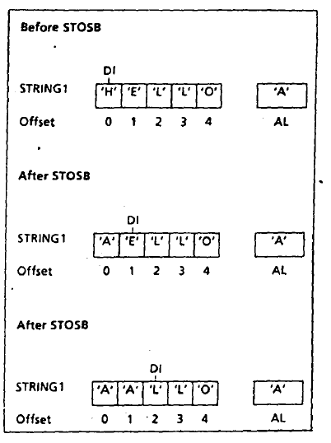
STOSB
LEA DI, STRING1
;DI POINTS TO DESTINATION STRING
MOV AL, ‘A’
CLD ;CLEAR DF
STOSB
STOSB

Slide 28
LODSB and LODSW
LODSB ; load string byte
LODSB moves the byte addressed by DS:SI (source) to AL.
SI is incremented if DF = 0 and decremented if DF = 1
LODSW ; load string word
LODSW moves the word addressed by DS:SI (source) to AX.
SI is increased by 2 if DF = 0 and decreased by 2 if DF = 1
LODSB and LODSW has no effect on the Flags

Slide 29
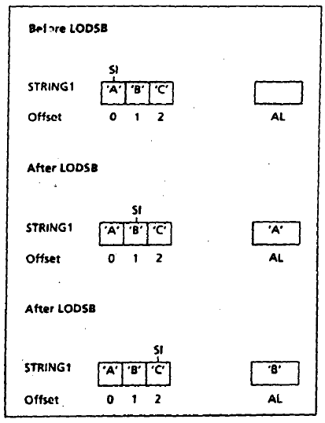
LODSB
LEA SI, STRING1
;SI POINTS TO SOURCE STRING
CLD ;CLEAR DF
LODSB
LODSB

Slide 30
SCASB and SCASW
SCASB ; scan string byte
SCASB scans the byte addressed by ES:DI to find a target byte stored in AL.
DI is incremented if DF = 0 and decremented if DF = 1
SCASW ; scan string word
SCASW scans the word addressed by ES:DI to find a target word stored in AX.
DI is increased by 2 if DF = 0 and decreased by 2 if DF = 1
SCASB and SCASW affects all status flags.

Slide 31
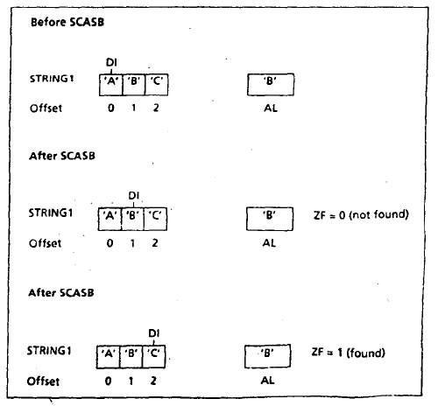
SCASB
LEA DI, STRING1
;DI POINTS TO STRING1
MOV AL, ‘B’
CLD ;CLEAR DF
SCASB
SCASB

Slide 32
REPNE and REPNZ
CX = number of bytes in the string
REPNE SCASB ; repeat SCASB while not equal to target
REPNZ SCASB ; repeat SCASB while CX not equal to zero
Both does the same thing.

Slide 33
CMPSB and CMPSW
CMPSB ; compare string byte
CMPSB subtracts the byte with address ES:DI from the byte with address DS:SI, and sets the flags.
SI and DI are incremented if DF = 0 and decremented if DF = 1
CMPSW ; compare string word
CMPSB subtracts the word with address ES:DI from the word with address DS:SI, and sets the flags.
SI and DI are increased by 2 if DF = 0 and decreased by 2 if DF = 1

Slide 34
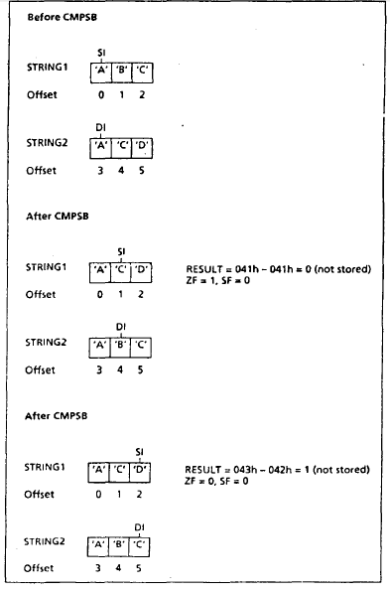
CMPSB
CLD
LEA SI, STRING1
;SI POINTS TO STRING1
LEA DI, STRING2
;DI POINTS TO STRING2
CMPSB
CMPSB

Slide 35
REPE and REPZ
CX = number of bytes in the shorter string
REPE CMPSB ; compare string bytes while equal
REPZ CMPSB ; compare string bytes while equal
Both instructions repeatedly executes CMPSB until
There is a mismatch between the two strings
CX = 0

Slide 36
An Example
M0V CX,10 ;length of the strings
LEA SI,STR1 ;SI points to STR1
LEA DT,STR2 ;DI points to STR2
CLD ;left to right processing
REPE CMPSB
JL STR1_FIRST ; STR1 precedes STR2
JG STR2_FIRST ; STR1 precedes STR2
MOV AX,0 ;if strings are identical
JMP EXIT
STR1_FIRST:
MOV AX, 1
JMP EXIT
STR2_FIRST:
MOV AX, 2
EXIT:
Compare two strings STR1 and STR2
If they are identical AX=0;
If STR1 comes first lexicographically, AX=1;
If STR2 comes first lexicographically, AX=2;

Slide 37
References
Ch 10, 11 Assembly Language Programming – by Yu and Marut

